Slide 1
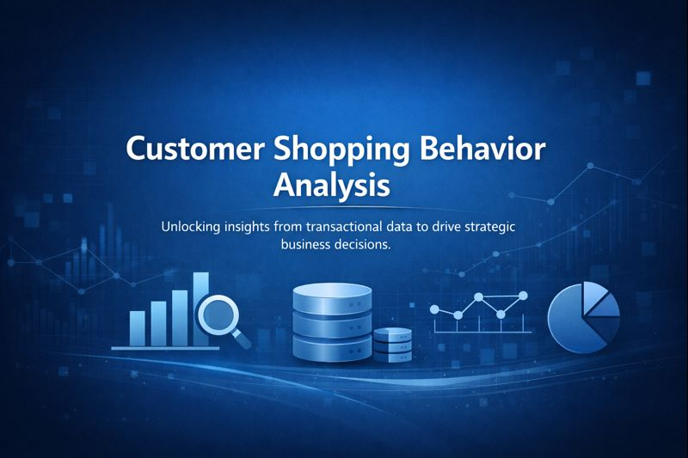
Customer Shopping Behavior Analysis
Unlocking insights from transactional data to drive strategic business decisions.

Slide 2


Project Overview
1
2
Data-Driven Decisions
Key Focus Areas
Customer segmentation, product preferences, and subscription behavior.
Analyzing 3,900 purchases to identify spending patterns, segments, and preferences.
3
Tools Utilized
Python, SQL Server, and Power BI for comprehensive analysis.

Slide 3
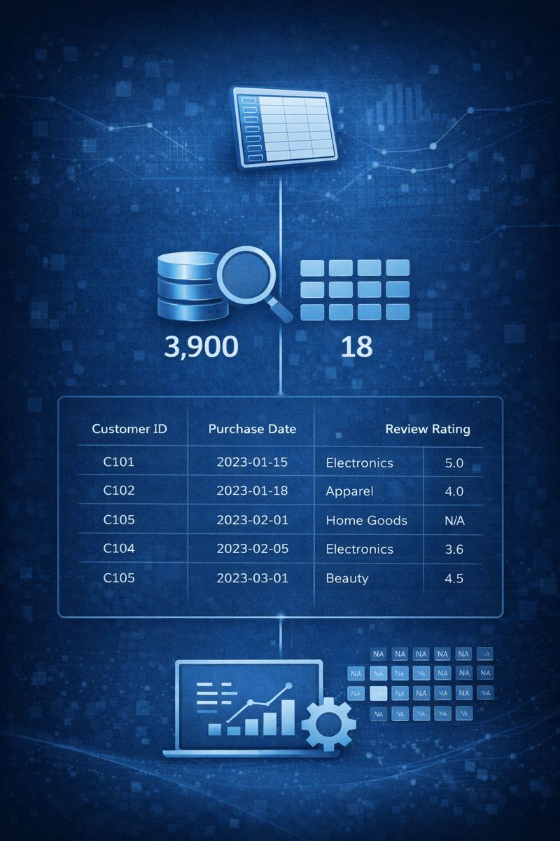
Data Summary: The Foundation
3,900
18
Rows
Columns
Total purchases analyzed
Data attributes
Key features include customer demographics, purchase details, and shopping behavior.
Missing data in 'Review Rating' (37 values) was handled during preparation.

Slide 4
Data Preparation with Python
01
02
03
Data Loading & Exploration
Missing Data Handling
Column Standardization
Imported dataset with pandas, checked structure and summary statistics.
Imputed 'Review Rating' null values using median product category rating.
Renamed columns to snake case for improved readability.
04
05
Feature Engineering
Data Export
Created 'age_group' and 'purchase_frequency_days' columns.
Cleaned data exported to CSV and loaded into Microsoft SQL Server.

Slide 5
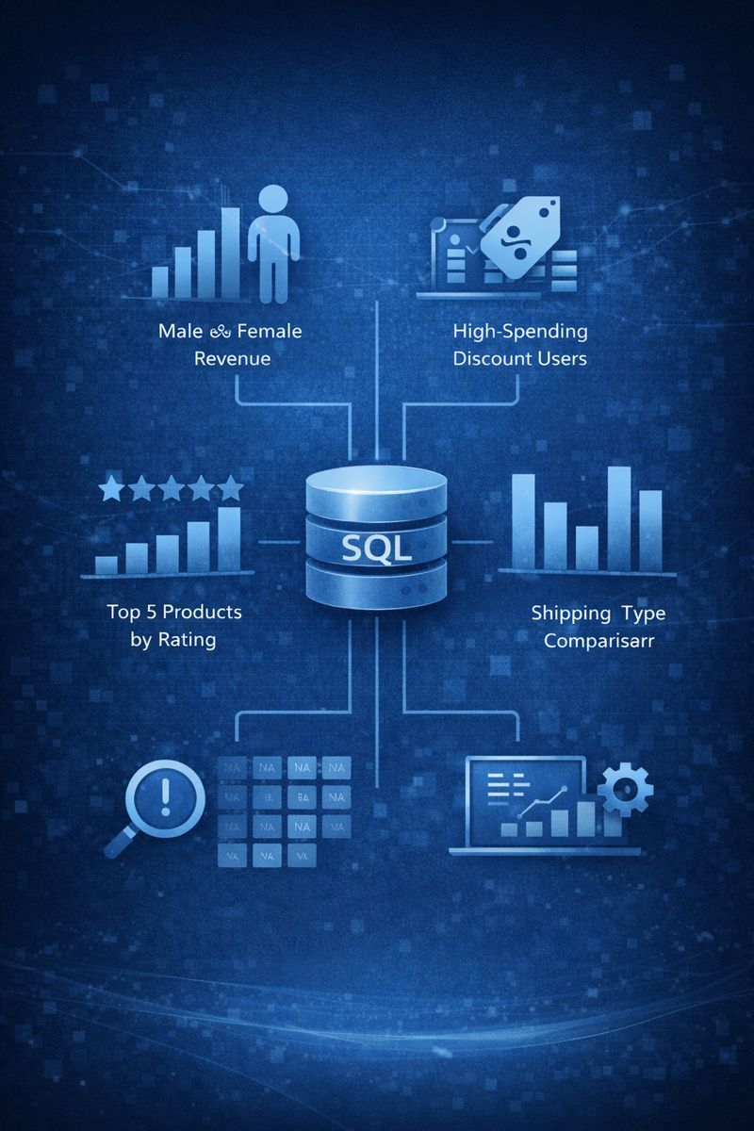
SQL Analysis: Key Business Questions
Revenue by Gender
Comparing total revenue from male vs. female customers.
High-Spending Discount Users
Identifying customers who used discounts but spent above average.
Top 5 Products by Rating
Finding products with the highest average review ratings.
Shipping Type Comparison
Average purchase amounts for Standard vs. Express shipping.

Slide 6

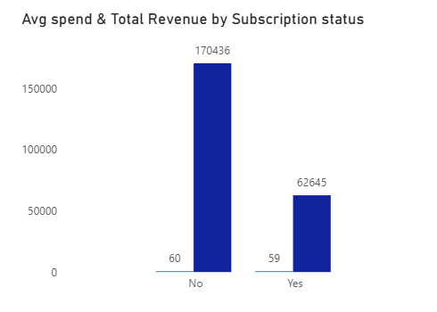
SQL Analysis: Deeper Dive
Subscribers vs. Non-Subscribers
Comparing average spend and total revenue.
Discount-Dependent Products
Top 5 products with the highest percentage of discounted purchases.
Customer Segmentation
Classifying customers into New, Returning, and Loyal segments.

Slide 7
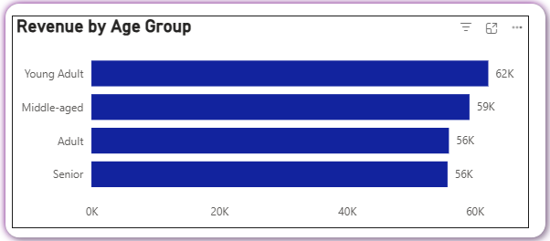
SQL Analysis: Product & Age Insights
Top 3 Products per Category
Repeat Buyers & Subscriptions
Most purchased products within each category identified.
Likelihood of subscription for customers with >5 purchases.
Revenue by Age Group
Total revenue contribution calculated for each age group.

Slide 8
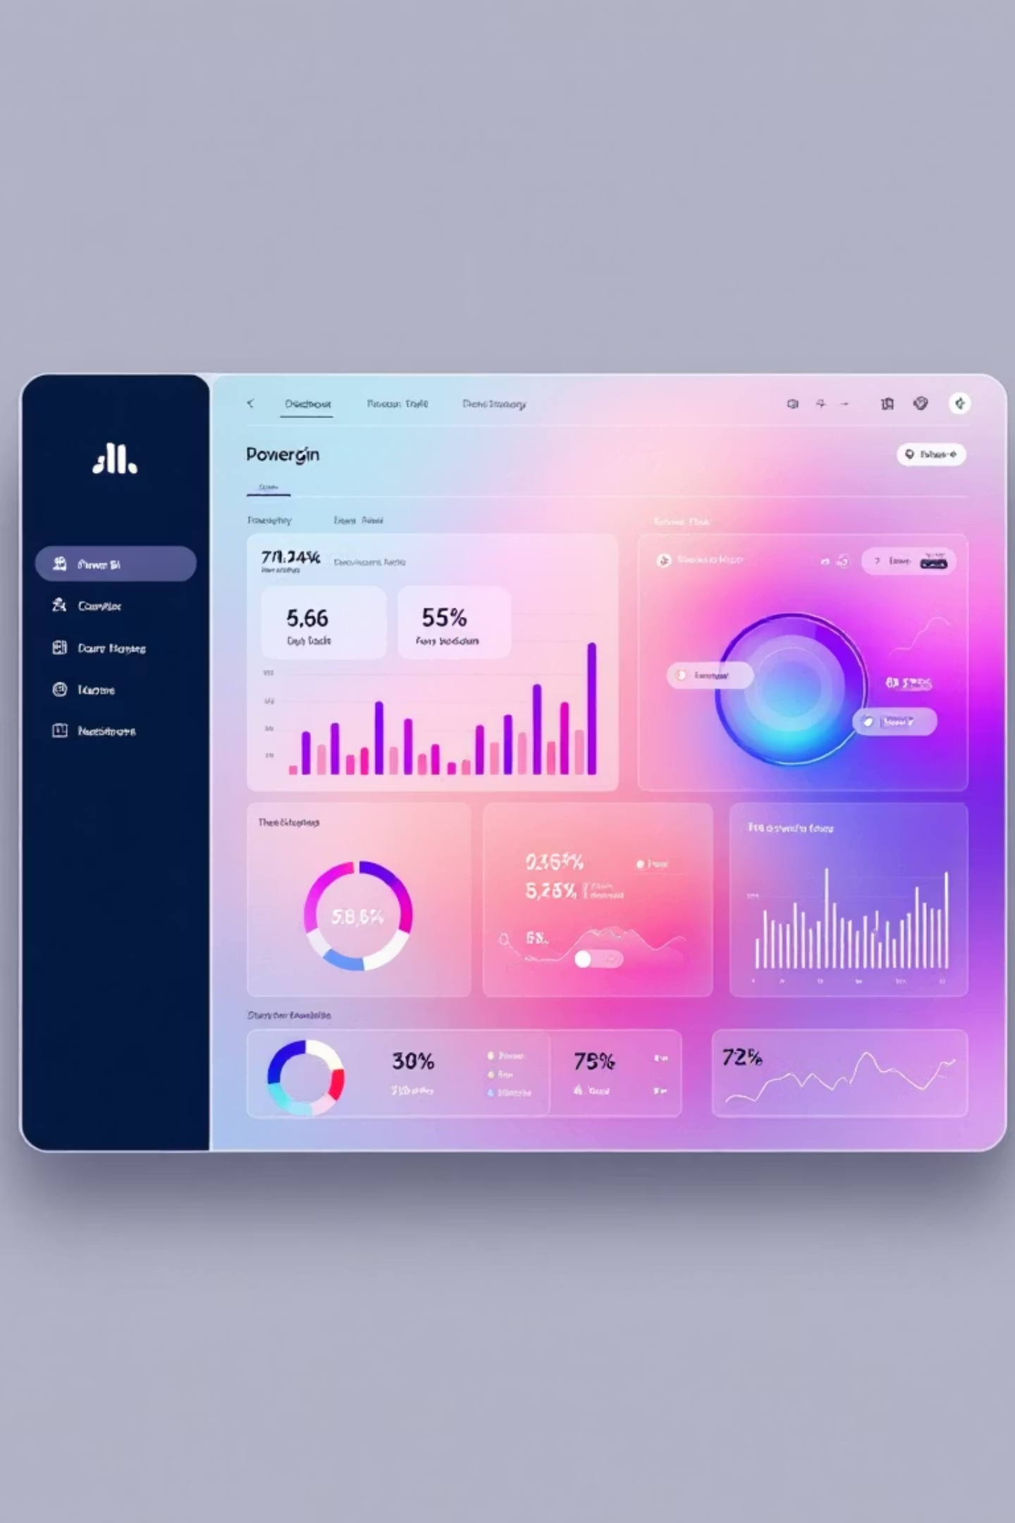
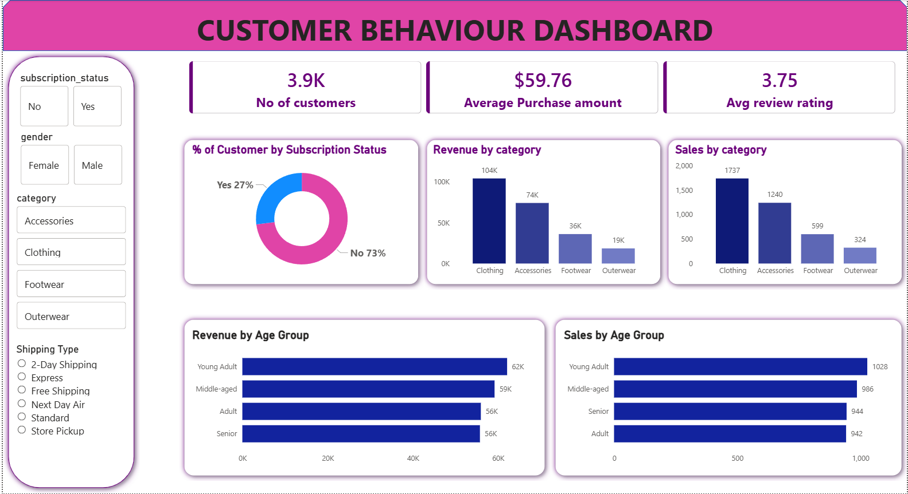
Power BI: Interactive Reporting
An interactive analytical report was built in Power BI to visualize insights from the SQL analysis and support business decision-making.
This report provides a dynamic view of customer behavior, enabling quick access to critical data.

Slide 9
Business Recommendations
Boost Subscriptions
Customer Loyalty Programs
Review Discount Policy
Promote exclusive benefits to increase subscriber base.
Optimize discounts to balance sales with profit margins.
Reward repeat buyers to foster loyalty and retention.
Product Positioning
Targeted Marketing
Highlight top-rated and best-selling products in campaigns.
Focus efforts on high-revenue age groups and express-shipping users.

Slide 10
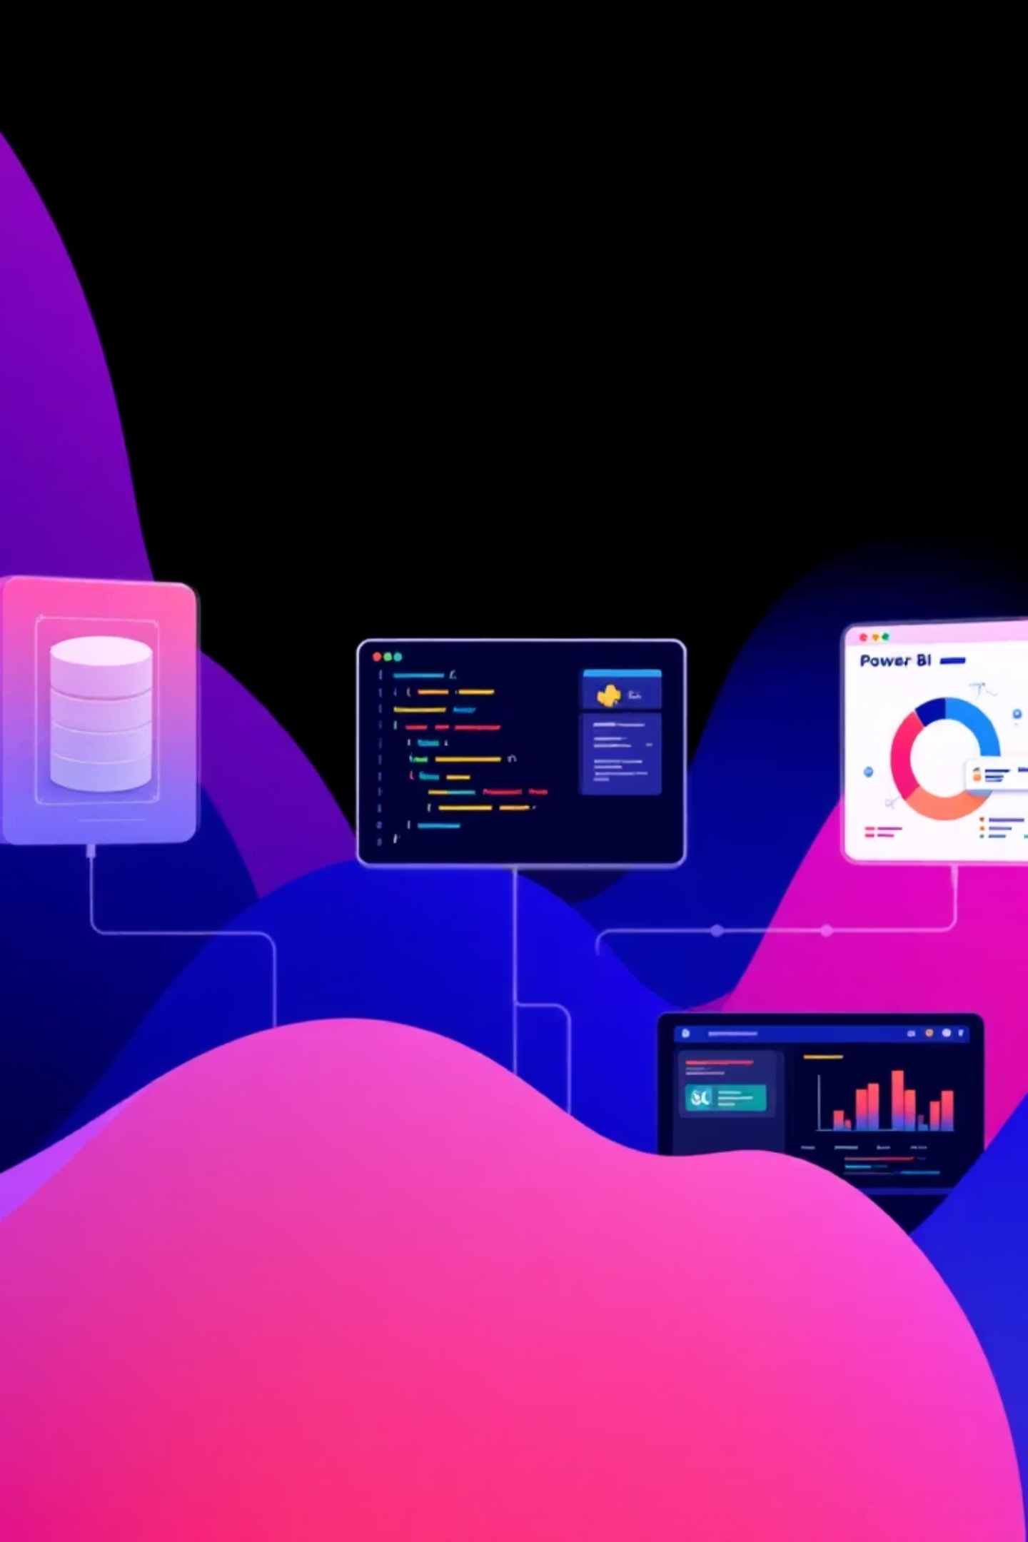



Tools & Technologies
Python
Data cleaning and feature engineering (Pandas, NumPy).
Microsoft SQL Server
Structured data analysis using SQL queries.
Power BI
Analytical reporting and visualization for insights.

